Slide 1
Lending Club Case Study
Group Id – 100093
Contributors:- Merson Sandeep, Paul Dhrubajyoti

Slide 2
Problem Statement
You work for a consumer finance company which specialises in lending various types of loans to urban customers. When the company receives a loan application, the company has to make a decision for loan approval based on the applicant’s profile. Two types of risks are associated with the bank’s decision:
If the applicant is likely to repay the loan, then not approving the loan results in a loss of business to the company
If the applicant is not likely to repay the loan, i.e. he/she is likely to default, then approving the loan may lead to a financial loss for the company
There are four major parts that are needed to be done for this case study.
Data Understanding
Data Cleaning
Data Analysis
Recommedations

Slide 3
Data Understanding
We have gone through the loan dataset and picked up the important variables which needs to be cleaned and analysed
List of Important Variables:
Loan amount
Term
Interest Rate
Grade
Sub grade
Annual Income
Purpose of Loan
Employment Length
Home ownership
Verification status

Slide 4
Data Cleaning
Cleaning of the data is very important step before we start analyzing by identifying the missing values and removing it.
Cleaned up the unnecessary columns by dropping it.
We found out more columns with null values hence dropped that column.
Corrected the employment length column by filling with mode value.
Created now columns by performing binning
Removed unwanted characters for columns to have a clean data
Partitioned month and year from the issue_d column
In the column loan_status, the value current denotes neither fully paid nor defaulted. So we got rid of this value as well.
Treated the outliers for annual income column

Slide 5
Observation [Points to Investor]
Loan applicants with grade 'B' and sub level 'B5'
Applicants having RENT as home ownership
Defaulters are more who opt for 36 months term
Applicants with verification status not verified
Applicants whose interest rate in the range 9%-12%
Applicants whose annual income is in the range 39K-55K
Defaulters are more where the loan is issued on the month of Dec
Every year there is a spike of 50% in defaulters
Applicants with purpose 'Debt_consolidation'
Applicants with employment length of 10 years

Slide 6
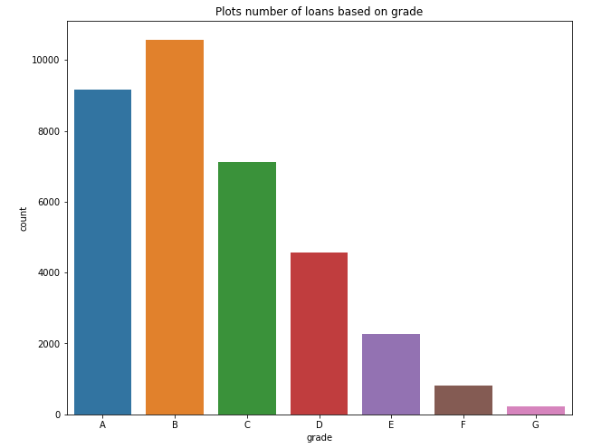
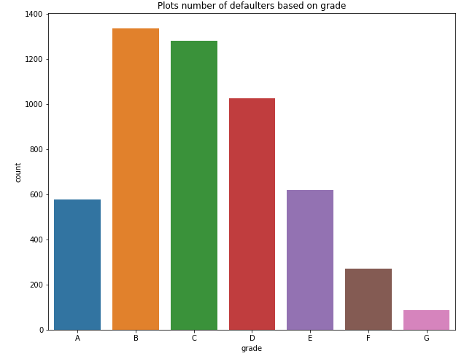
Data Analysis and Visualization
Please find the plots which we have created for analysis by visualizing it.
Observations :- Loan applicants with grade ‘B’

Slide 7
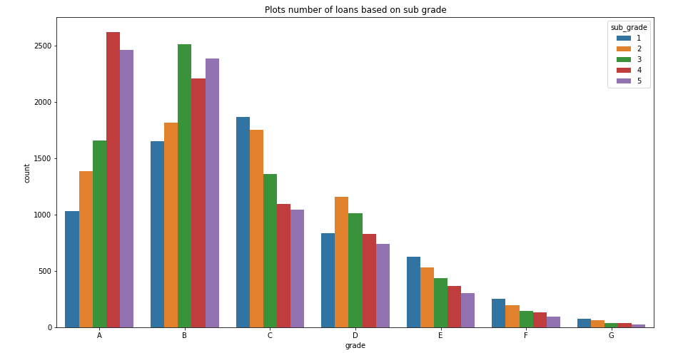
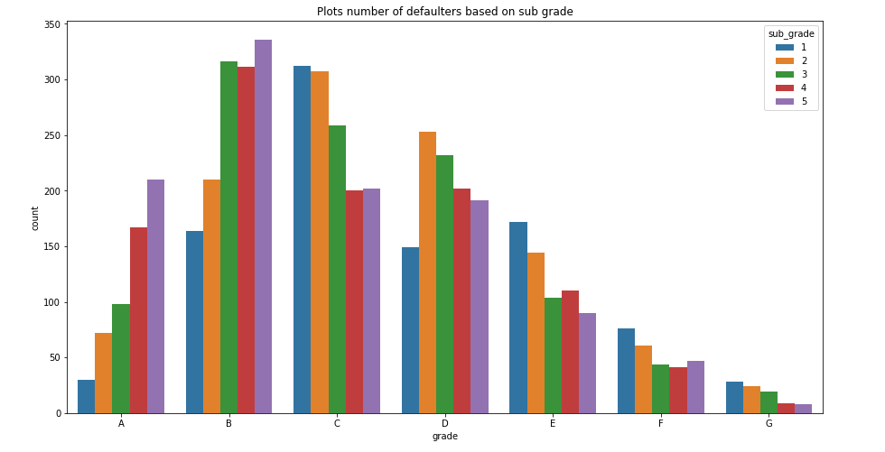
Observations :- Loan applicants with sub level 'B5’

Slide 8
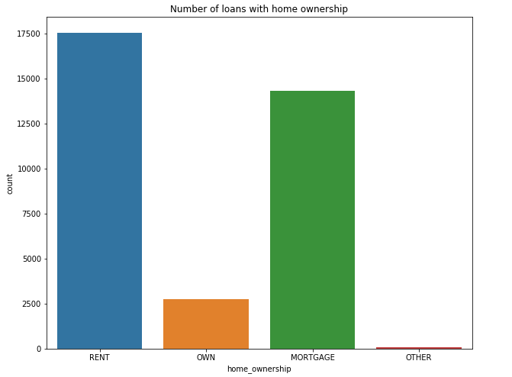
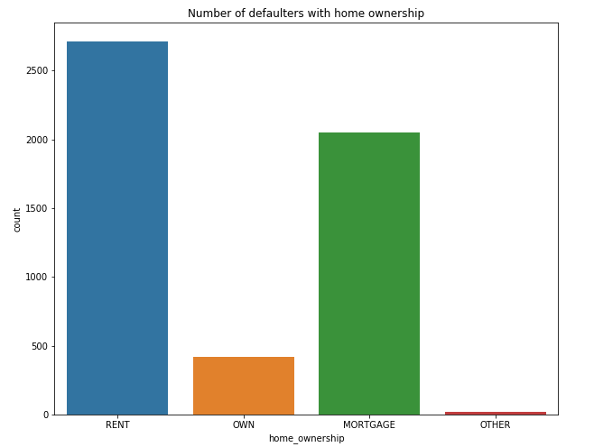
Observations :- Applicants having RENT as home ownership

Slide 9
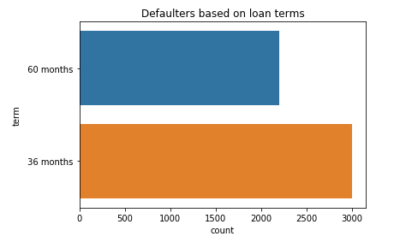
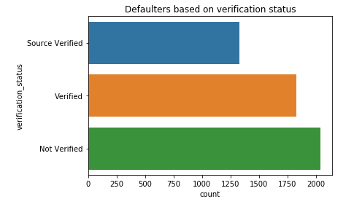
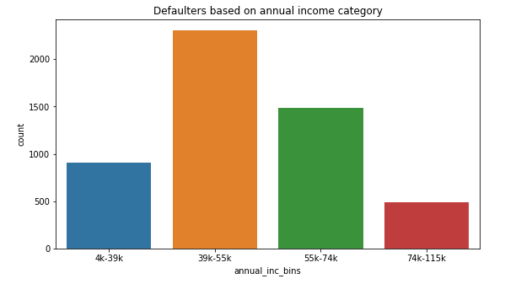
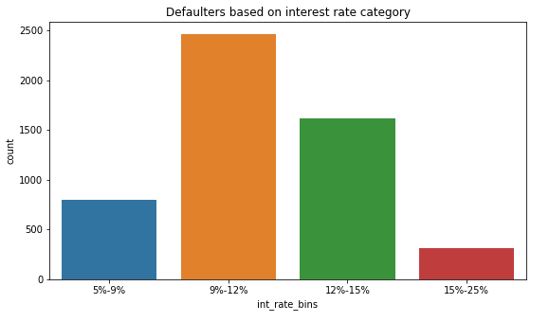
Observations :-
Defaulters are more who opt for 36 months term.
Applicants with verificaiton status not verified
Applicants whose interest rate in the range 9%-12%
Applicants whose annual income is in the range 39K-55K

Slide 10
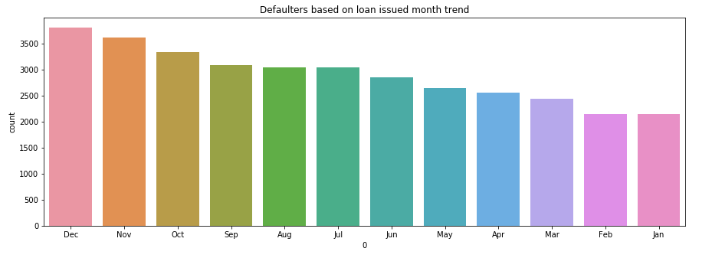
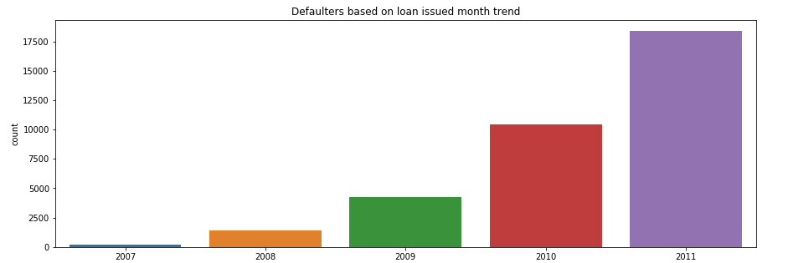
Observations :- Defaulters are more where the loan is issued on the month of Dec and every year there is a spike of 50%

Slide 11
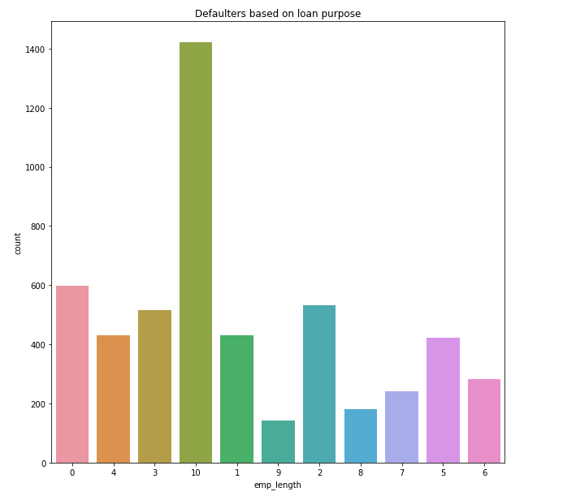
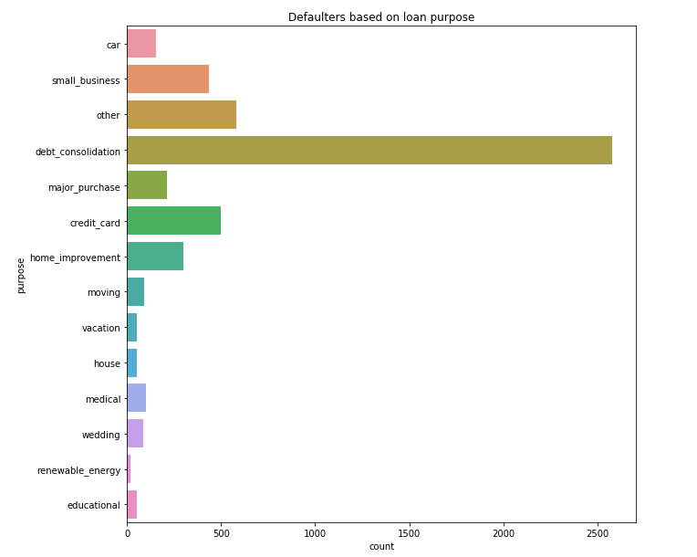
Observations :-
Applicants with purpose 'Debt_consolidation’ and applicants with employment length of 10 years

Slide 12
Observation [Points to Investor]
Applicants annual income range of 55k-65k and home ownership is MORTAGE
Applicants whose verification status is verified and annual income is above 55k
Applicants whose verification status is verified and funded amount from investor is above 14k
Applicants whose home ownership is MORTAGE and OTHER with requested loan amount above 12k
Applicants whose home ownership is MORTAGE and funded amount from investor is in the range of 10k-12k
Applicants with grade 'G' and interest rate is above 20%
Applicants with 10 years employment and request loan amount above 12k

Slide 13
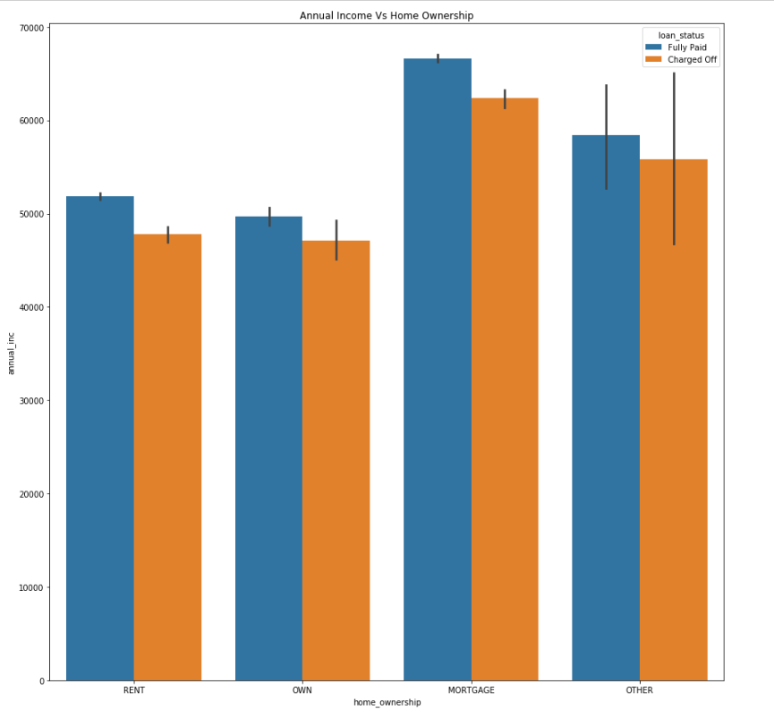
Observations :- Applicants annual income range
of 55k-65k and home ownership is MORTAGE are defaulters

Slide 14
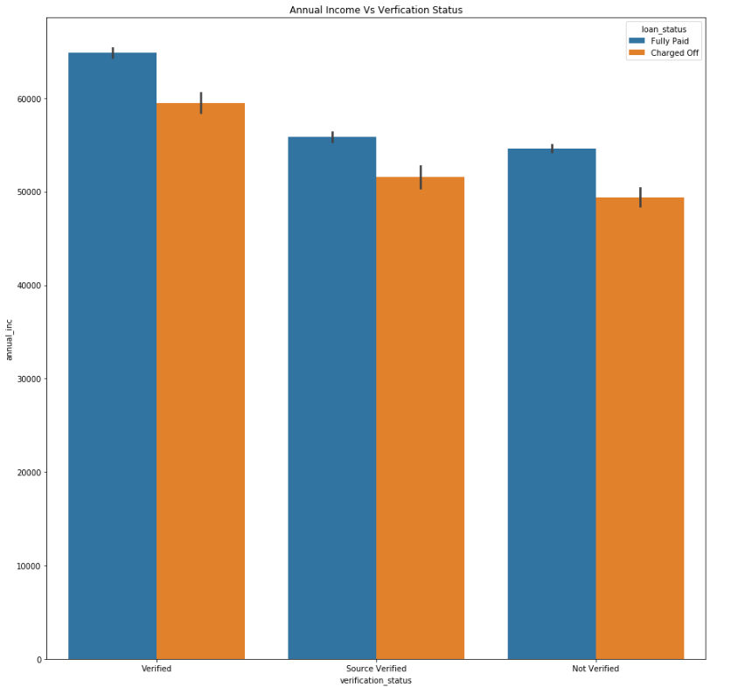
Observations :- Applicants whose verification status
is verified and annual income is above 55k
are defaulters

Slide 15
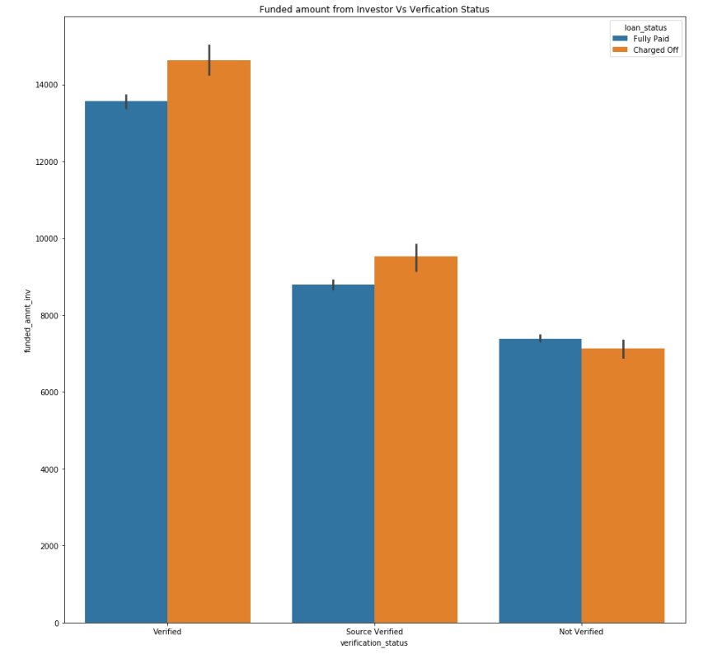
Observations :- Applicants whose verification status
is verified and funded amount from investor is above 14k
are defaulters

Slide 16
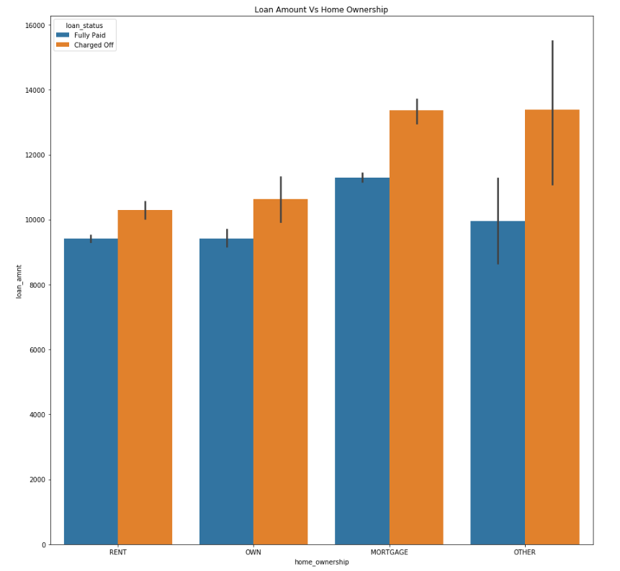
Observations :- Applicants whose home ownership
is MORTAGE and OTHER with requested loan amount
above 12k

Slide 17
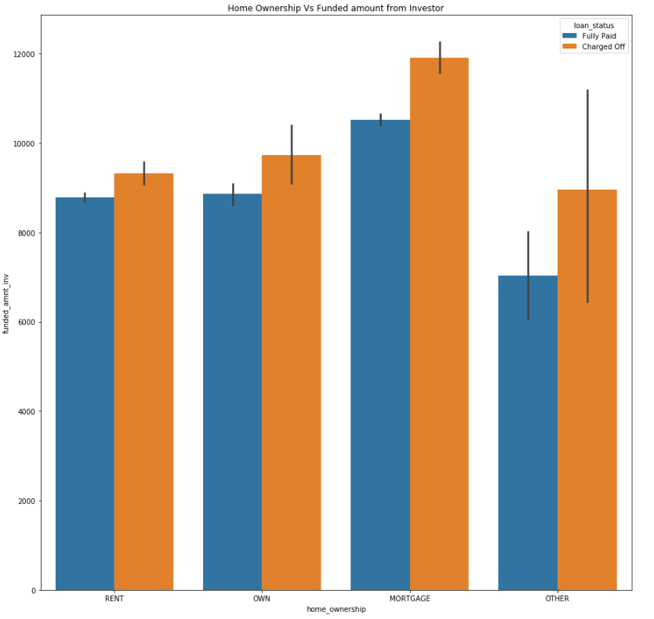
Observations :- Applicants whose home ownership is
MORTAGE and funded amount from investor is in the
range of 10k-12k

Slide 18
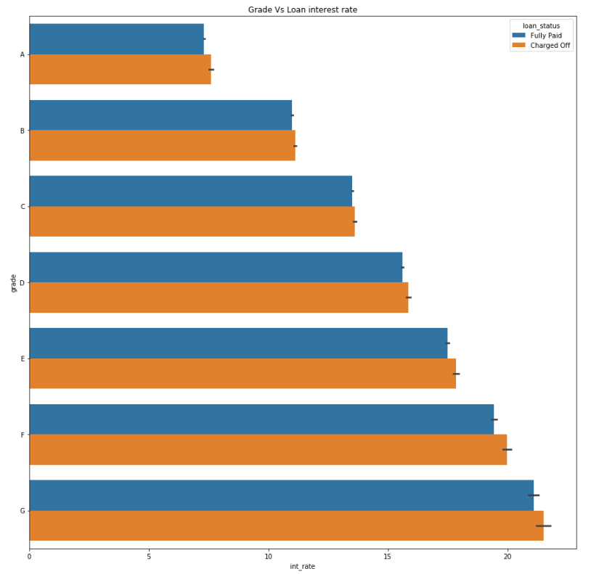
Observations :- Applicants with grade 'G' and
interest rate is above 20%

Slide 19
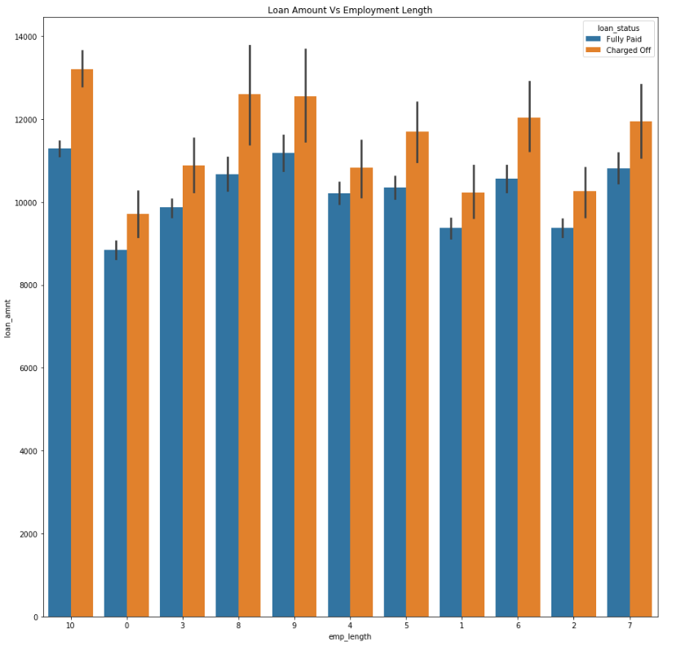
Observations :- Applicants with 10 years employment
and request loan amount above 12k

